Slide 1





Mentorness Internship Project
On
Heart Attack Prediction
By,
Shobha Kumari Choudhary
Notes:
Hello all, myself Shobha kumari Choudhary. As a part of Mentorness internship program I have build a machine learning project on heart attack prediction. This is a supervised machine learning classification problem aims at finding the risk associated with the heart disease
By analyzing various medical and demographic factors that can estimate the likelihood of a heart attack.

Slide 2


Today’s Agenda
Problem
Statement
Dataset
Preview
Exploratory
Data Analysis
Modelling Approached Used
Best Optimal Model
Performance Metrices
Model Comparison
Business Insights & Recommendations
Notes:
Today, Agenda : here I will discuss on PS that is predicting the risk associated with heart disease, then I will give preview on dataset, then I will talk about EDA part and uncover some useful insights that causes heart attack also some preventive measures, then I will discuss the modelling approach used . then I will compare the models built based on accuracy score, then next will the optimal model I built using ML. and their performance metrices. And lastly i will give business insights & recommendations.

Slide 3


Problem Statement
Heart disease is one of the leading causes of death worldwide. Early prediction of heart attack risk can significantly improve patient outcomes by enabling timely medical intervention and lifestyle changes. By analyzing various medical and demographic factors, it is possible to develop a predictive model that can estimate the likelihood of a heart attack.
Objective
Develop a machine learning model that can predict the risk of a heart attack based on a set of medical and demographic variables.
Notes:
Heart attack is one of the most pressing problems of the health care industry. The main reasons for the significant increase in heart disease in recent years are people’s lifestyle, lack of exercise, and consumption of various processed foods. Heart disease in its advanced stages can cause heart attacks and endanger the lives of patients, so it is necessary to detect the disease quickly and in its early stages with intelligent and therapeutic methods. Early detection of this disease is vital to save people’s lives. The aim of this model building is an attempt to reduce the efforts and time put in by the doctor by automating the risk prediction with the help of a binary classifier. Machine Learning (ML), is one of the most convenient, fastest, and low-cost ways to detect disease.

Slide 4
Dataset preview
Overview of Datasets
Our dataset contain Patients information including various features that can help in Predicting the Risk of Heart Attack.
The Features Include
age: Age of the patient
sex: Sex of the patient (1 = male, 0 = female)
cp: Chest pain type
trestbps: Resting blood pressure (in mm Hg)
chol: Serum cholesterol (in mg/dl)
fbs: Fasting blood sugar (1 = fasting blood sugar > 120 mg/dl, 0 = otherwise)
restecg: Resting electrocardiographic results
thalach: Maximum heart rate achieved
exang: Exercise-induced angina (1 = yes, 0 = no)
oldpeak: ST depression induced by exercise relative to rest
slope: Slope of the peak exercise ST segment (0 = upsloping, 1 = flat, 2 = downsloping)
ca: Number of major vessels (0-3) colored by fluoroscopy
thal: Thalassemia (3 = normal, 6 = fixed defect, 7= reversible defect)
target: Target variable (1 = heart attack risk, 0 = no risk)
Notes:
The features in the dataset used to train the model and the selection of the ML algorithm have a significant impact on the performance of the model.

Slide 5
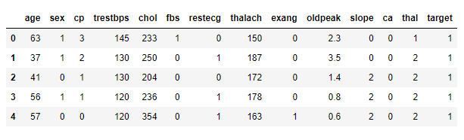
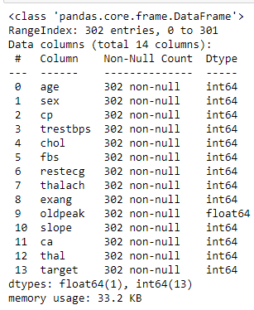
Data Ingestion
Sample of the Dataset
Dataset contain 302 Rows & 14 Features.
There are no NULL values present in the Dataset.
There are no Duplicates.

Slide 6
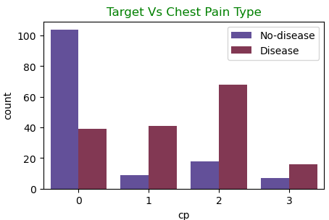
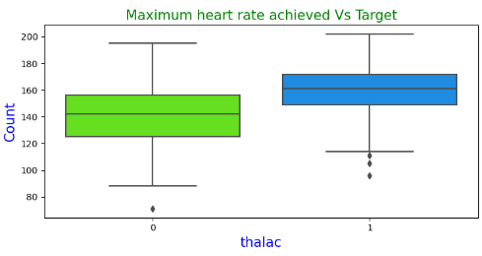
Exploratory data Analysis
Maximum Patients suffer from type-0 chest pain. This is the most common chest pain type.
Maximum Heart Disease occur with type-2 chest pain.
Patients at a risk of heart disease achieve more rate.
Notes:
On the various I have done EDA and found some valuable insights causing heart attack. Based on chest pain & target column I found that max patients have type-0 cp but risk of heart disease occur with patients having type-2 cp which is alarming and need to take care of using proper medications.
And patients with max heart rate are more prone to heart disease.

Slide 7
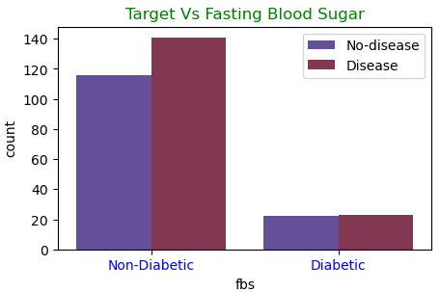
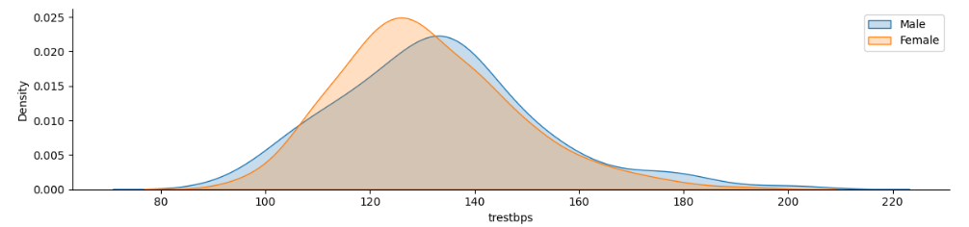
Exploratory data Analysis
Non-Diabetic patients are more at a Risk of Heart disease.
It might be due to as Diabetic patients are already on a controlled diet, so their risk of Heart Disease is Low.
Female has lower resting Bloop Pressure as compared to men.
For female it is around 120 and for male it is around 140.
Notes:
Non- diabetic patients r more at a risk of heart disease. It might be due to as Diabetic patients are already on a controlled diet, so their risk of Heart Disease is Low.
Also found that bp level of male is more compared to female as a result male are more at a risk of heart disease.

Slide 8
Modelling Approach Used
Data Cleaning
Data Encoding
Data Transformation
Train – Test Split
Models Built
Data is cleaned for any Anomalies present in the dataset.
Null values, Outlier Treatment, incorrect Datatype mapping were all done using Appropriate methods.
All the Categorical columns were Encoded using Dummy Encoding.
Model building Algorithm can’t handle Categorical data, so we need to convert into encoded integers.
Features are Transformed (Scaled) using Standard Scalar.
Train – Test split is done using the 70 : 30 ratio.
Built various models and checked Accuracy against the Test data.
Done Hyper-parameter Tuning to get Better Accuracy and Generalized models.
Notes:
Various preprocessing (outlier detection, normalization, etc.) and feature selection processes were applied to the dataset.

Slide 9
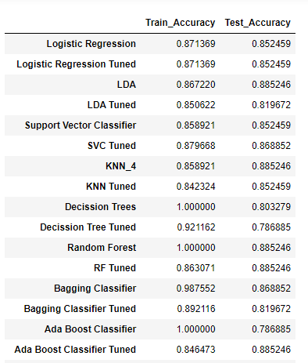

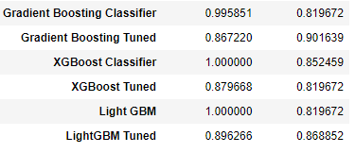
Model Comparison
Notes:
The models obtained by training the feature-selected dataset with different ML algorithms were tested, and their performances were compared. The highest performance was obtained for the GDB classifier model trained on the dataset.
examined the performance of ML models such as Logistic Regression (LR), Decision Tree (DT), Random Forest (RF), Support Vector Machine (SVM), SVM with grid search (SVMG), K-Nearest Neighbour (KNN) for heart disease classification.

Slide 10

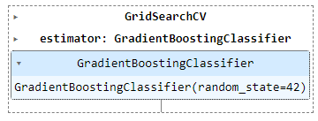
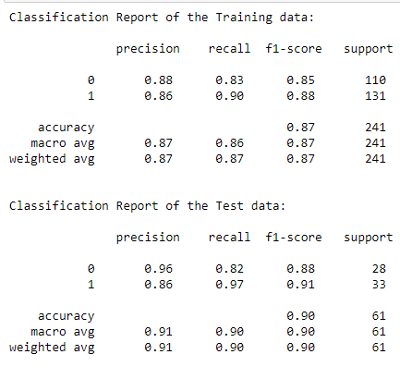
Best Optimal Model
Best Optimal model is Tuned Gradient Boosting Classifier model.
The Accuracy in Train data is 86% and in Testing data Accuracy is 90%.
Classification Report
Notes:
The highest performance was obtained for the GDB classifier model trained on the dataset with precision, recall, accuracy and Area under curve of 86%, 89%, 90% and 96% respectively. In this section, the proposed method has been implemented on the test data, and the results have been compared with other ML methods

Slide 11


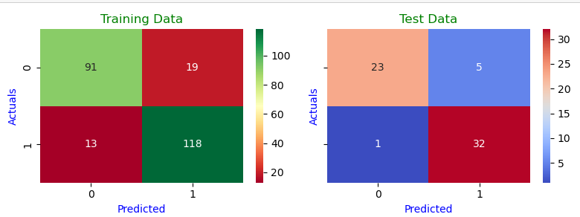
Confusion Matrix
Performance
Matrices
True Positive : 32
True Negative : 23
False Positive : 5
False Negative : 1
Notes:
confusion matrix is used to evaluate the performance of ML models. The confusion matrix is a table showing the difference between the actual and predicted classes. Each row of the confusion matrix represents an instance in the predicted class, while each column represents an instance in the real class (and vice versa). The confusion matrix usually contains four different terms: True Positive (TP), False Positive (FP), True Negative (TN), and False Negative (FN).

Slide 12
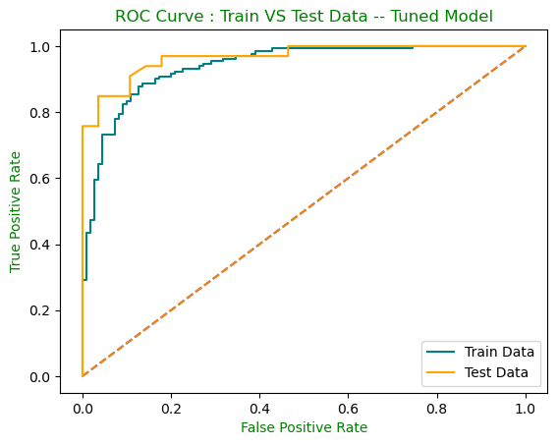
ROC – AUC Curve
AUC for Train data is 93% and AUC for Test data is 96%.
The AUC & ROC curve shows that it is covering almost the same area for Train and Test data. Therefore, this is considered a Generalized good model.
Also, the AUC score is high and can distinguish between Positive and Negative classes vey well.
Notes:
The ROC curve is a curve showing the performance of a classification model at different thresholds. Auc measures the entire area under ROC curve.
AUC is the measure of the ability of a classifier to distinguish between classes.

Slide 13
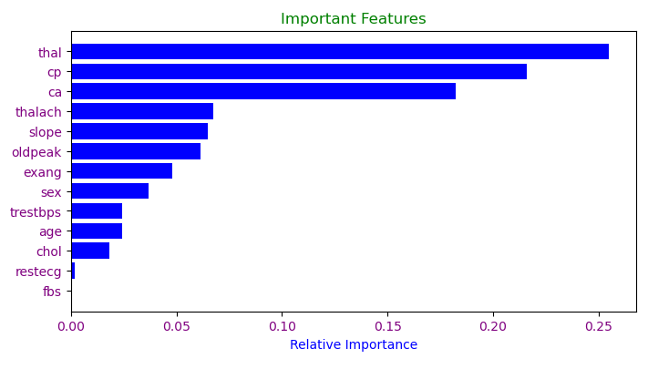
Feature Importance
The important features for predicting the Risk of heart attack are : thal, cp, ca, thalach & slope.
Notes:
The main objective of this study is to select the optimum features from the heart disease dataset and use it in the Machine Learning method to classify the healthy and non-healthy heart disease data. Some of the features do not have more efficiency in the classification of heart disease.

Slide 14
Business Insights & Recommendations
Recommendations
The 1st five Important features of Tuned GDB model are: thal, cp, ca, thalach & slope.
These 5 features are Contributing most towards the Accuracy of the Model.
Since these 5 features are contributing most towards the Accuracy, the business should ensure that these features should not contain any Anomalies, Null values or any kind of unwanted characters as a part of these columns in the future.
Also, we should make sure these 5 features are made compulsory for :
Predicting Heart attack Risk
For model building and
Insights
Optimized Tuned GDB Model is performing better with highest AUC score of 96%.
So, we can say that these Models are able to Separate between the Risk and No-Risk Classes Very well.
These models can be considered a Good Generalized models.

Slide 15

Thank You

